Slide 1
CSCI 331 – Group Project 3
Members: Timothy Dakis (Group Leader), Mikhaiel Gomes, Shivanie Kemraj (Backup Group Leader), Konrad Rakowski, Kevin Tang

Slide 2
Project Management
This section of the presentation will show aspects of project management, it will include:
The project plan
3 stages:
1) Planning Phase
2) Implementation Phase
3) Presentation Phase
Briefly speak of how the group assisted each other
Briefly speak about how RedGate toolbelt helped us during the project
Screenshots of all to-do lists by member
Screenshot of Gannt chart

Slide 3
The Project Plan
Our project was broken into three distinct phases, summarized as follows:
Planning Phase
This is where we would ask our initial questions to Professor Heller and then come up with ideas for the implementation phase
Implementation Phase
This is where we would implement things based off our plans
Presentation Phase
This is where we would make our slides in recordings showcasing the implementations

Slide 4
Planning Phase

Slide 5
Step 1: Ask Professor Heller Questions
Note: Videsh is someone from another group, we had just both attended the same office hour to ask Heller questions

Slide 6
Step 2: Make a Plan PDF (with aid of Lucidcharts ERD diagrams)

Slide 7
Step 3: Review the plan
No one had any feedback, so the plan remained unchanged from the previous slide.

Slide 8
Implementation Phase

Slide 9
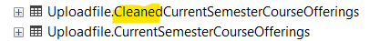
Step 1: Cleanse the database
This will be elaborated on later, but essentially looked for issues in the database and decide how to clean them, and then apply the cleaning changes
Applied cleaning by making a second table with the changes, to allow for cleaner functions and procedures for loading tables:

Slide 10
Step 2: Set up the UDTs and Tables
Implement the design based on the plan
Adhered to the following name conventions:
Use PascalCase for Column/Table/UDT/Schema names
Primary Keys: PK_TableName
Check Constraints: CK_TableName_[FittingName]
Unique Constraints: AK_ColumnName
Foreign Keys: FK_ChildTableName_ParentTableName
Set up functions and procedures related to loading the tables
Group leader then compiles all the work into the master version of the database

Slide 11
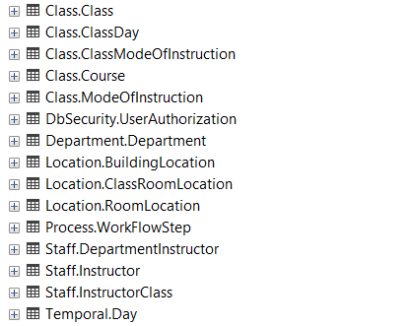
Tables of the database

Slide 12
Presentation Phase
Step 1: Make slides
Step 2: Record portions of the slides

Slide 13
Use of Discord, and how the Group Assisted Each other
No formal meetings held during the project

Slide 14
In Lieu of Regularly Scheduled Meetings…
We utilized Discord to organize and manage parts of the project and deadlines

Slide 15
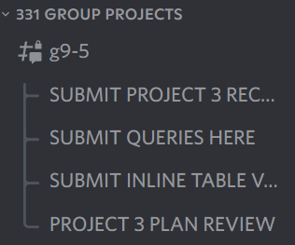
Example: to ensure everyone’s work is submitted, threads were used to compile results

Slide 16
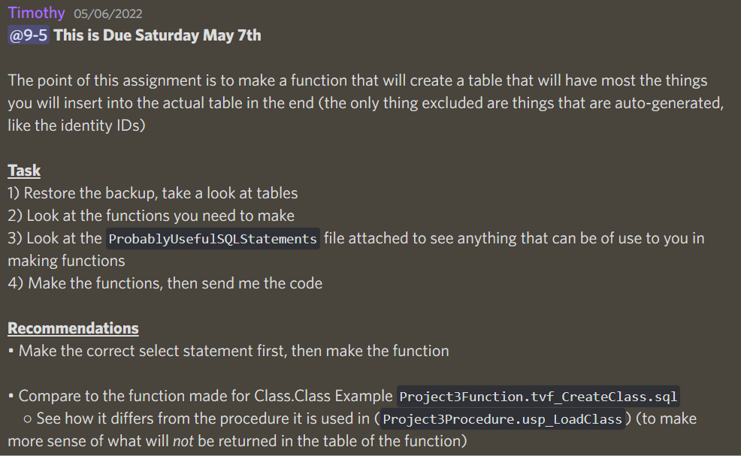
Example: Utilizing Discord to announce deadlines for people, as well as provide information

Slide 17
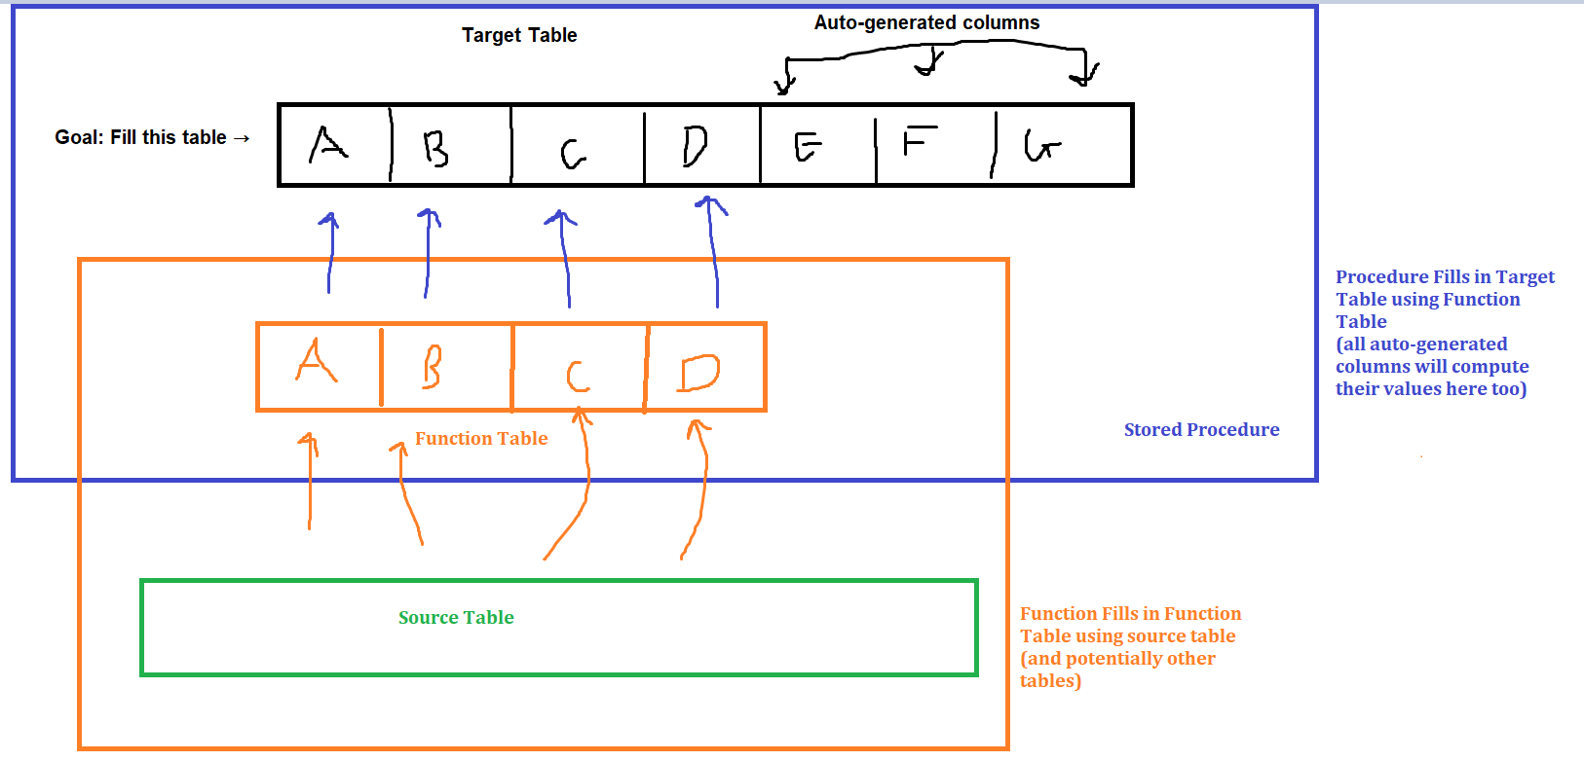
Group Assistance
Assisted in making queries / functions when faced issues
Assisted in understanding why the database was designed the way it was
Assisted in explaining how the procedures and functions are related
A diagram made in order to aid in explaining how the procedures and functions were related

Slide 18
Use of RedGate

Slide 19
How RedGate Assisted Us
SQLPrompt: Generally useful for auto-fill purposes, and giving default options for INNER JOINS
Also used it to automatically add [] around object names

Slide 20
To-Do List and Gannt Chart

Slide 21
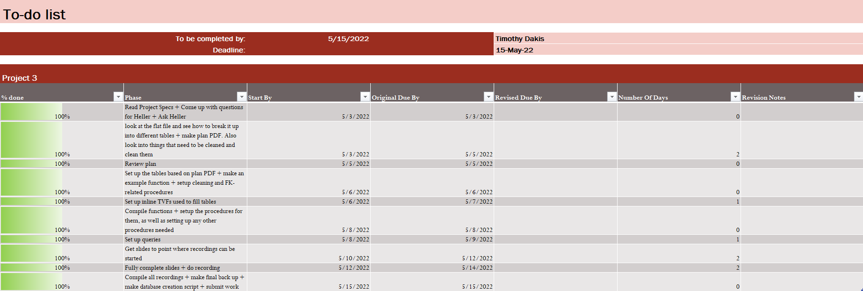
To-Do List For Timothy Dakis

Slide 22
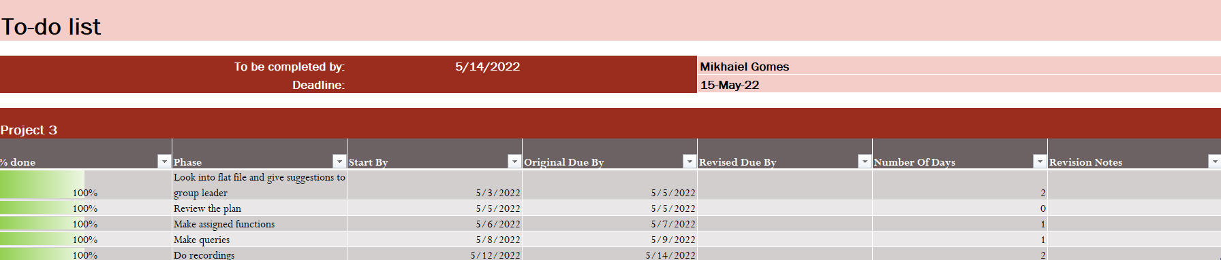
To-Do List For Mikhaiel Gomes

Slide 23
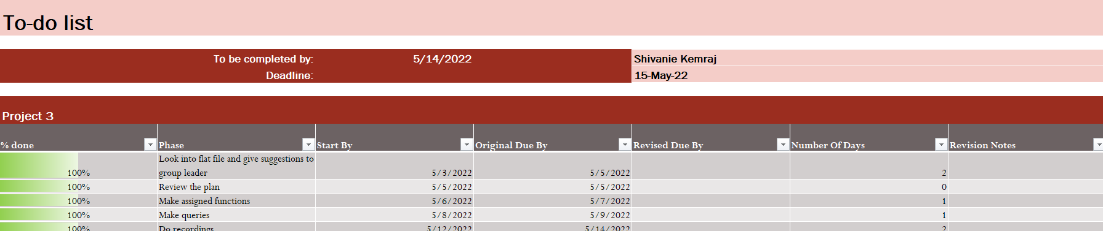
To-Do List For Shivanie Kemraj

Slide 24

To-Do List For Konrad Rakowski

Slide 25

To-Do List For Kevin Tang

Slide 26
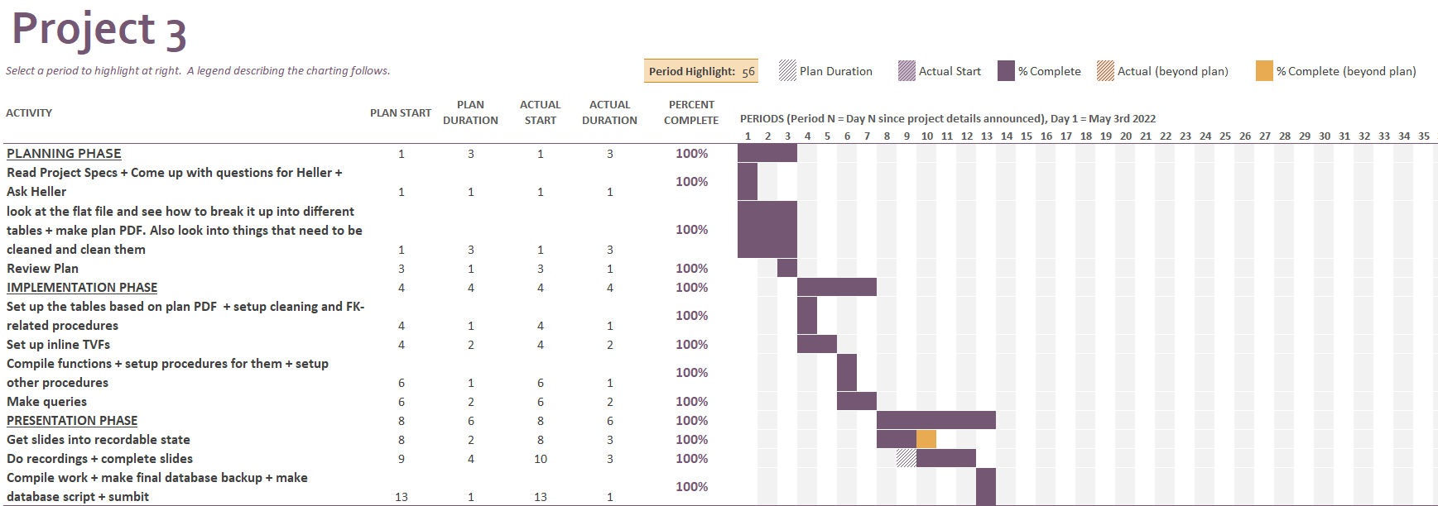
Gannt Chart

Slide 27
The Project Part
This part of the presentation will show aspects related to implementing the project itself in more depth. It will include:
Showcase the WorkFlowStep and UserAuthorization tables
Go over our logic for why our database is designed the way it is (e.g., denormalized in some cases for easier querying)
CDM/LDM showcases of the tables of the database
Data cleansing (why and how things were cleaned)
The UDT hierarchy, along with why each UDT exists, how reusable each one was, and when in the project they were decided
Will showcase all schemas made for the database, and what is in each
PDMs of each table
Will show an overview of the table
Will explain why columns were either added or removed or modified compared to flat file
Will explain why the constraints added were added
Each stored procedure (and related function)
Segmented by which procedures (and related functions) were done by whom
Will show outputs where applicable (namely for procedures that load a table, will output the table)
Queries done on the database
Segmented by which queries were done by whom
Go over an issue faced due to the design, along with how the overall design could be improved

Slide 28
DbSecurity.UserAuthorization and Process.WorkFlowStep

Slide 29
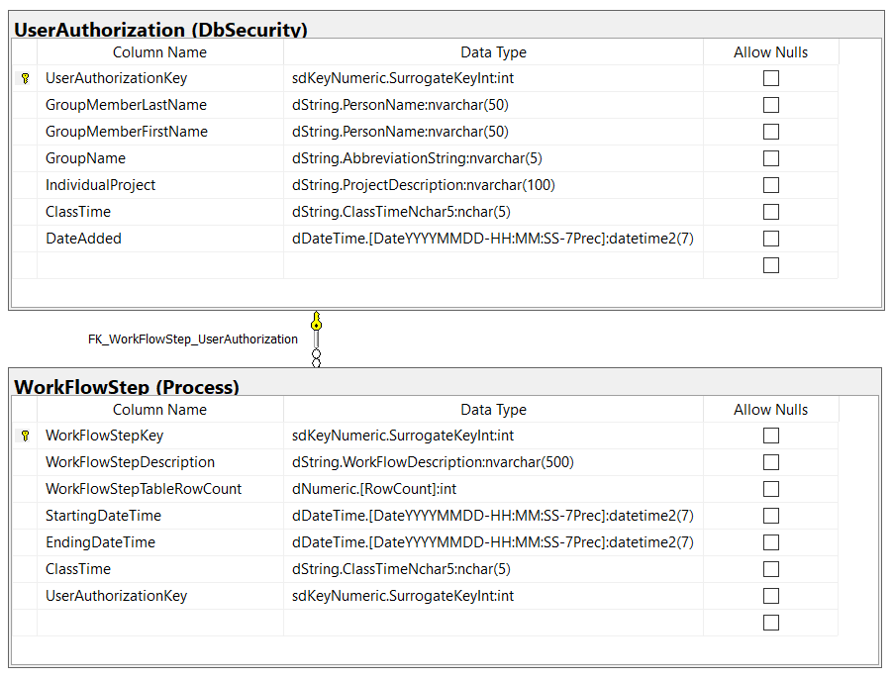
Standard-view PDM of DbSecurity.UserAuthorization and Process.WorkFlowStep

Slide 30
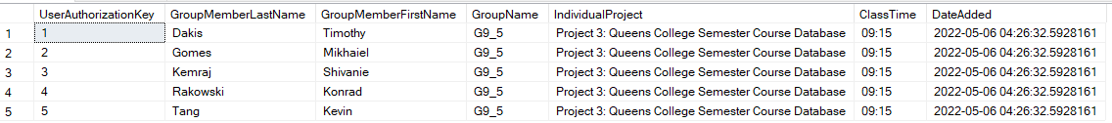
Everything has a FK Relationship with the DbSecurity.UserAuthorization Table

Slide 31
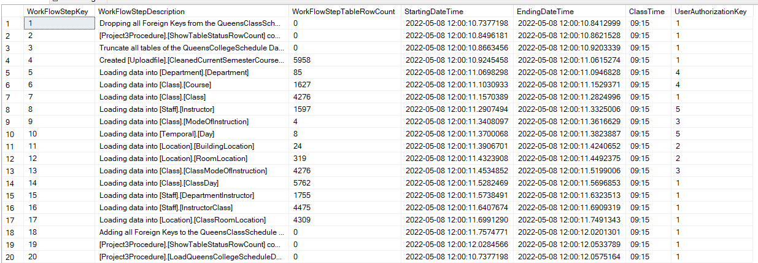
Overview of the Process.WorkFlowStep table

Slide 32
Why our Database was Designed the way it was

Slide 33
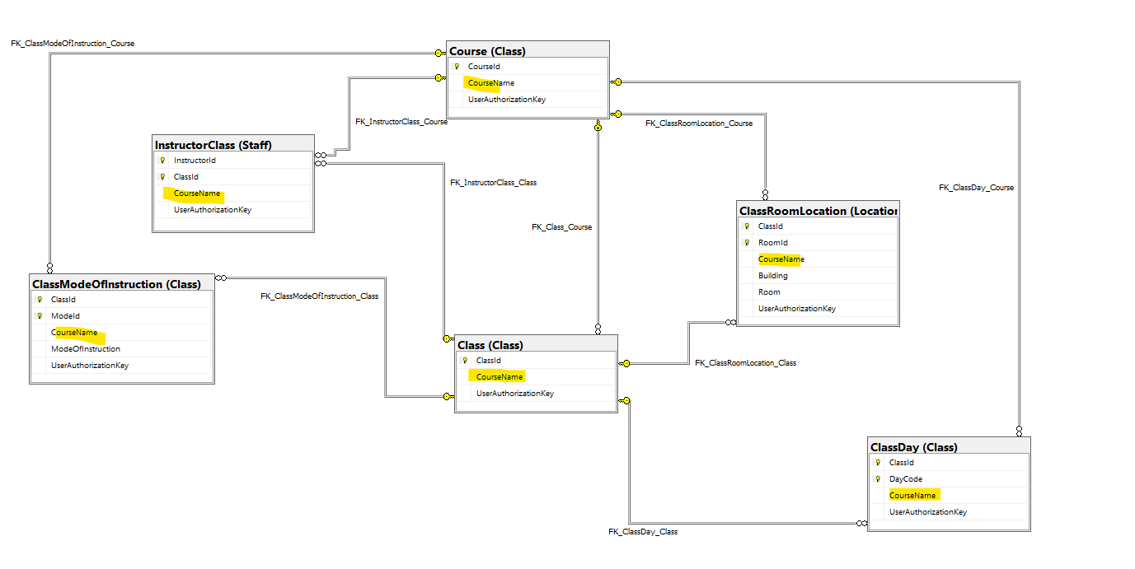
1) Easier Querying as a result of some denormalization
The Class table, along with the bridge tables, have (a) column(s) in them that have information that you would likely be looking for, but would have had to have joined tables to acquire

Slide 34
2) Related: Assumption is that Tables Would not be Inserted into Directly, only as a Result of Calling the load Procedure
This means did these denormalization attempts, despite how it increases anomalies, as the underlying assumption is that any changes would occur on the fileupload file, and then the tables would be reloaded via the procedure loading the entire database
Therefore, should not have been able to run into these data anomaly issues despite not perfect normalization

Slide 35
CDM and LDM of the Database

Slide 36
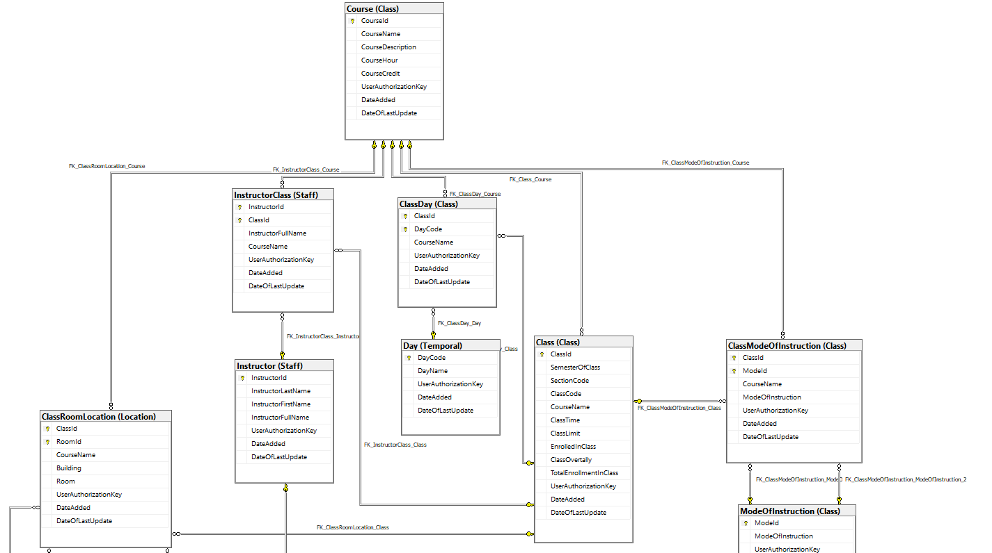
Logical Data Model (LDM) Part 1

Slide 37
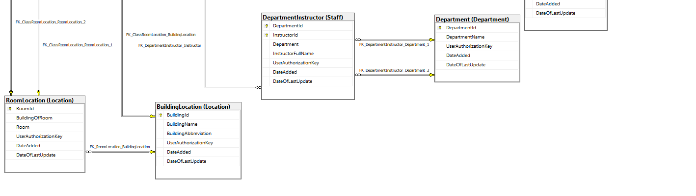
LDM Part 2

Slide 38
LDM Combined

Slide 39
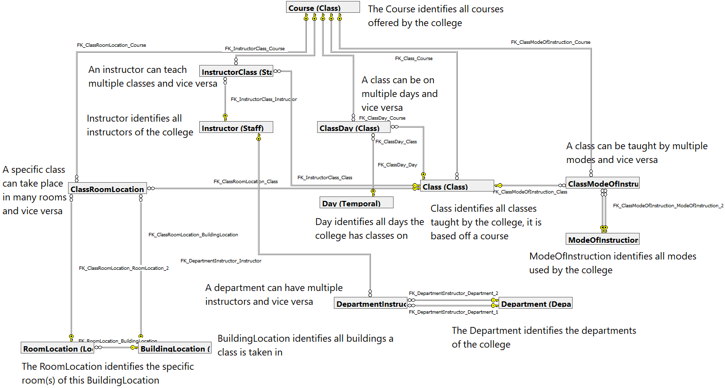
Conceptual Data Model (CDM)

Slide 40
Data Cleansing
What we found
How we cleaned it
Overall, we have a procedure that makes a duplicate table to clean

Slide 41
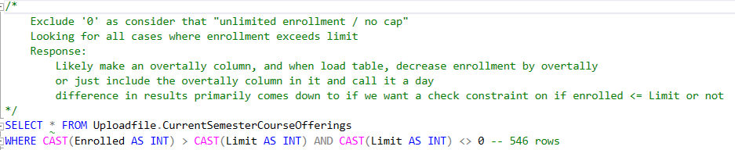
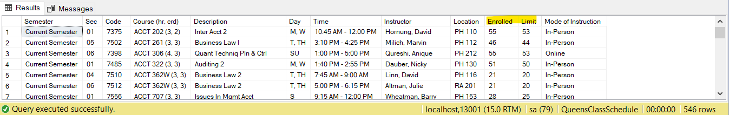
Cleansing Part 1: Class Limit < Enrollment Count

Slide 42
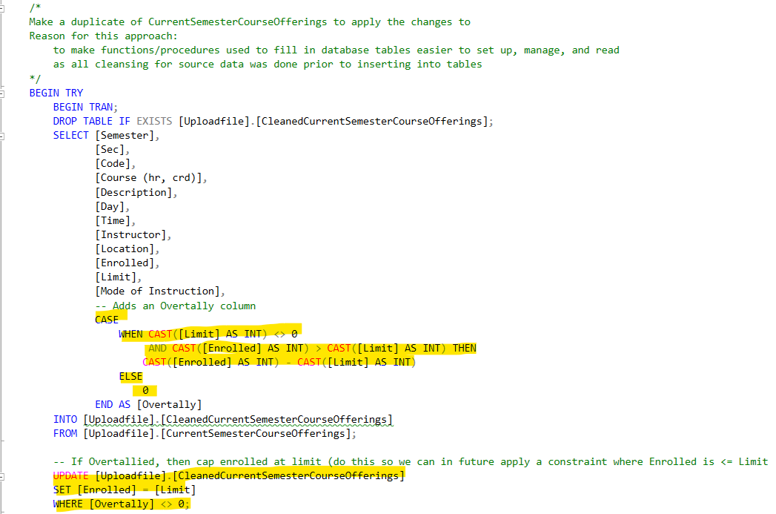
Part 2: How it was Dealt With

Slide 43
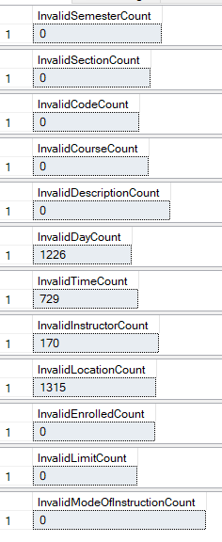
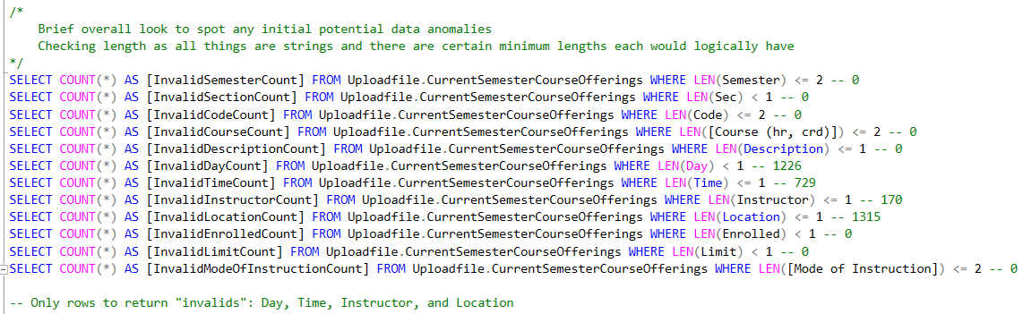
Part 3: Looking for Possible Abnormalities

Slide 44
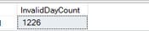
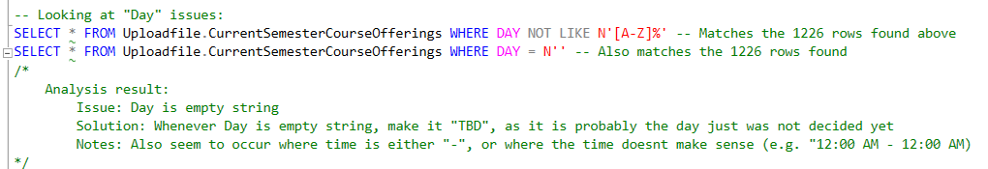
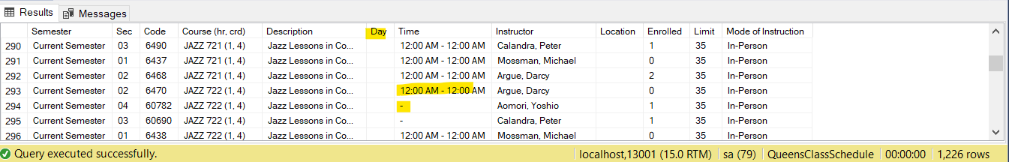
Part 4: Looking into the Day issues Spotted

Slide 45
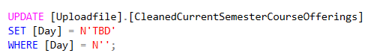
Part 5: How it was Dealt With

Slide 46
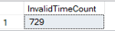
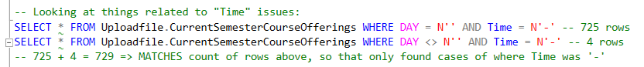
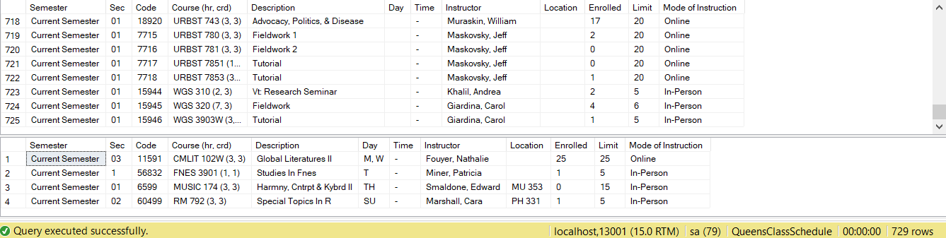
Part 5: Looking into the Time Issues Spotted

Slide 47
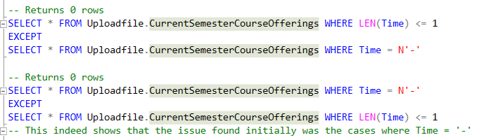
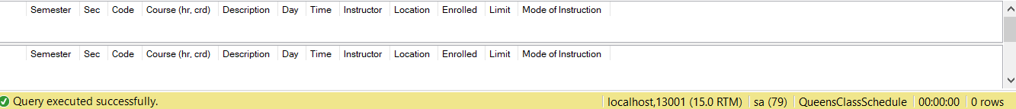
Part 6: Looking into the Time Issues Spotted (Part 2)

Slide 48
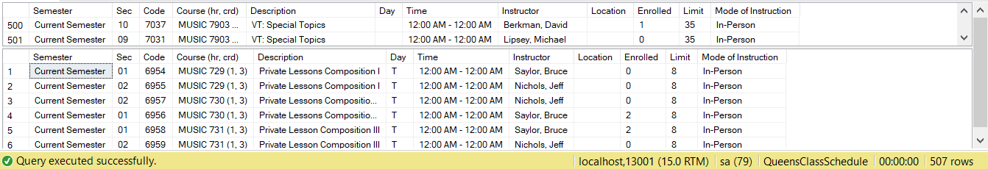
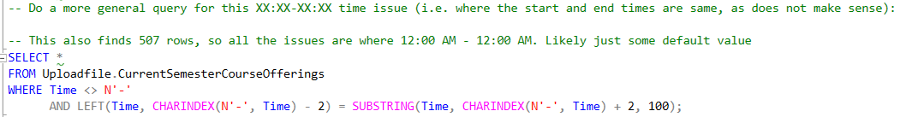
Part 7: Looking into the Time Issues Spotted (Part 3)

Slide 49
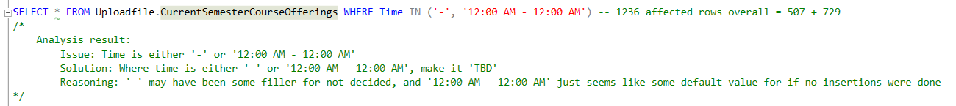
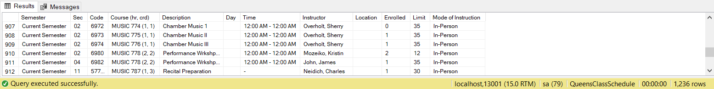
Part 8: Looking into the Time Issues Spotted (Part 4)

Slide 50
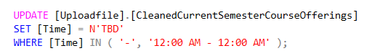
Part 9: How it was Dealt With

Slide 51
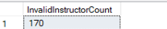
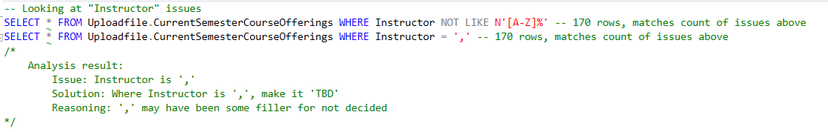
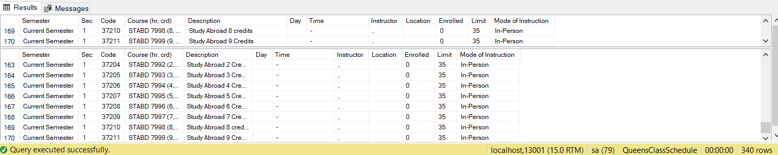
Part 10: Looking into the Instructor Issues Spotted

Slide 52
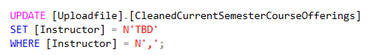
Part 11: How it was Dealt With

Slide 53
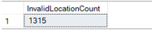
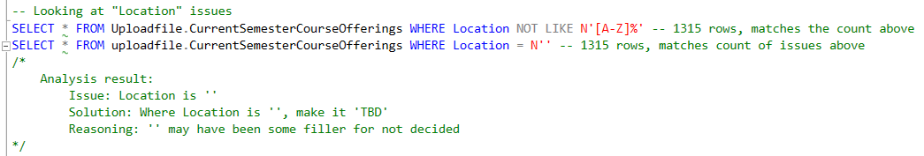
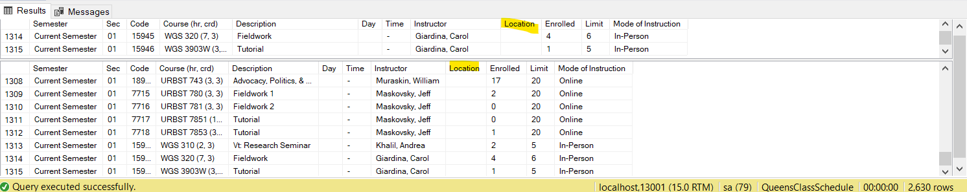
Part 12: Looking into the Location Issues Spotted

Slide 54
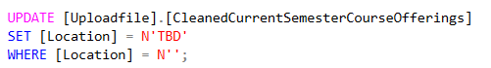
Part 13: How it was Dealt With

Slide 55
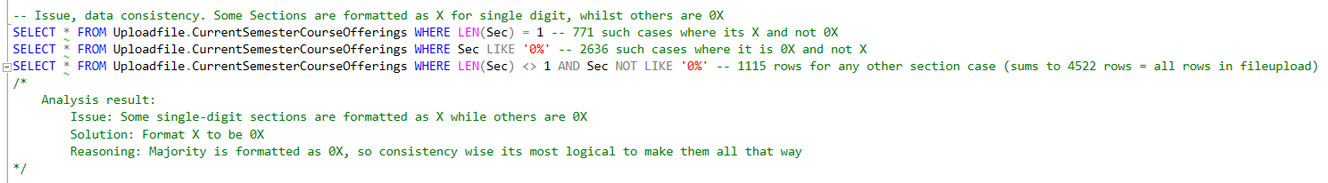
Part 14: Section Code Format Consistency
771 + 2636 + 1115 = 4522 rows = all rows in fileupload

Slide 56
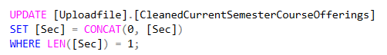
Part 15: How it was Dealt With

Slide 57
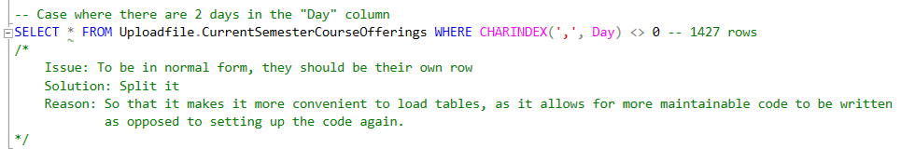
Part 16: Cases Where There is >1 day in a Column

Slide 58
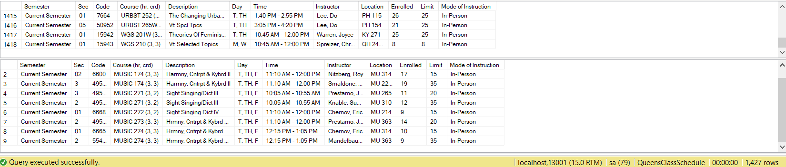
Part 17: Cases Where There is >1 day in a Column (Part 2)

Slide 59
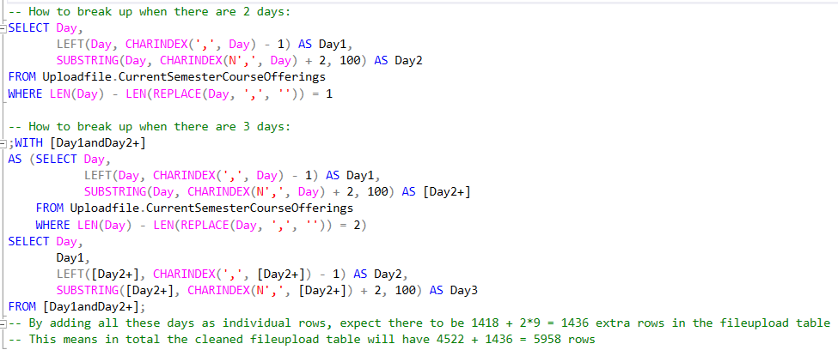
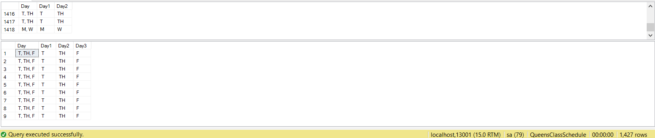
Part 18: Cases Where There is >1 day in a Column (Part 3)

Slide 60
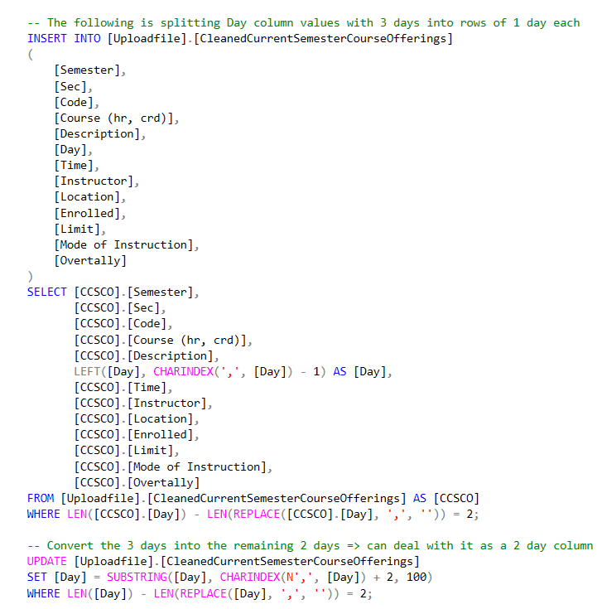

Part 19: How it was Dealt With
Dealing with 3 days:
Dealing with 2 days:

Slide 61
Part 20: Analysis File (An Overview)

Slide 62
Part 21: Cleansing Procedure (An Overview) (Shown Again Later In Procedure Section)

Slide 63

Part 22: Fileupload Output (not Cleaned)

Slide 64

Part 23: Fileupload Output (Cleaned)

Slide 65
UDTs (User Defined Data Types)
Layout of this Section:
Show UDT Hierarchies
Break down each UDT (frequency, reason made/for data type, and when in project it was decided)

Slide 66


UDT Hierarchy Part 1
Numeric (Domain)
RowCount (based on int)
KeyNumeric (Subdomain)
SurrogateKeyInt (based on int)
ClassNumeric (Subdomain)
ClassStatistic (based on smallint)
ClassStatisticDecimal (based on decimal(5,2)
DateTime (Domain)
DateYYYYMMDD-HH:MM:SS-7Prec (Based on DateTime2(7))

Slide 67

UDT Hierarchy Part 2
String (Domain)
WorkFlowDescription (based on nvarchar(500))
ProjectDescription (based on nvarchar(100))
AbbreviationString (based on nvarchar(4))
ClassTimeNchar5 (based on nchar(5))
PersonName (Based on nvarchar(50))
DayName (Based on nvarchar(16))
ClassString (Subdomain)
CourseName (Based on nvarchar(14))
DepartmentName (Based on nvarchar(6))
CourseDescriptionString (Based on nvarchar(40))
EncodingString (based on nvarchar(5))
SemesterString (based on nchar(16))
ClassTimeInterval (based on nvarchar(20))
ModeType (Based on nvarchar(12))
LocationString (Subdomain)
RoomString (Based on nvarchar(9))
BuildingName (Based on nvarchar(25))

Slide 68


UDT Frequency Table

Slide 69
UDT Breakdown Part 1 (The following UDTs were decided during planning)
Domain Name: | sdKeyNumeric.SurrogateKeyInt
Frequency: | 32
Data Type: | INT
Reason: | To have a generic type for surrogate keys. Integer as there could theoretically be many rows.
Domain Name: | dDateTime.DateYYYYMMDD-HH:MM:SS-7Prec
Frequency: | 29
Data Type: | DATETIME2(7)
Reason: | To have a generic type for tracking time. Datetime2(7) for tracking precision in cases you would require finding time differences.

Slide 70
UDT Breakdown Part 2
Domain Name: | dString.PersonName
Frequency: | 6
Data Type: | NVARCHAR(50)
Reason: | To have a generic type for name-related fields. Nvarchar(50) as longest name in database is ~30 characters, so 50 characters give a lot of extra leeway.
Domain Name: | sdClassString.CourseName
Frequency: | 6
Data Type: | NVARCHAR(14)
Reason: | To have a type specific type for course name fields. Nvarchar(14) as longest course name is ~14 characters.

Slide 71
UDT Breakdown Part 3
Domain Name: | dString.AbbreviationString
Frequency: | 5
Data Type: | NVARCHAR(5)
Reason: | To have a reusable generic type for fields using abbreviations. Nvarchar(5) as related fields contain data of max 5 characters
Domain Name: | sdClassNumeric.ClassStatistic
Frequency: | 5
Data Type: | SMALLINT
Reason: | To have a reusable generic type for tracking statistics related to classes (e.g., how many people are enrolled). Smallint as these values do not get that big, but big enough that tinyint doesn’t work.

Slide 72
UDT Breakdown Part 4
Domain Name: | dString.ClassTimeNchar5
Frequency: | 2
Data Type: | NCHAR(5)
Reason: | To have a type specific to our group’s class time. Nchar(5) as ‘09:15’ is a fixed 5 characters so there is no variability.
Domain Name: | sdClassString.DepartmentName
Frequency: | 2
Data Type: | NVARCHAR(6)
Reason: | To have a type specific to department names. Nvarchar(6) as longest department name is 5 characters so gives slightly more leeway.

Slide 73
UDT Breakdown Part 5
Domain Name: | sdClassString.EncodingString
Frequency: | 2
Data Type: | NVARCHAR(5)
Reason: | To have a type specific to strings used for coding. Nvarchar(5) as longest section / class codes get is 5 characters.
Domain Name: | sdClassString.ModeType
Frequency: | 2
Data Type: | NVARCHAR(12)
Reason: | To have a type specific to mode of instruction. Nvarchar(12) as longest mode of instruction is 12 characters.

Slide 74
UDT Breakdown Part 6
Domain Name: | sdLocationString.RoomString
Frequency: | 2
Data Type: | NVARCHAR(9)
Reason: | To have a type specific to rooms. Nvarchar(9) as longest room name is 8 characters, so this gives a bit more leeway.
Domain Name: | sdClassString.SemesterString
Frequency: | 1
Data Type: | NCHAR(16)
Reason: | To have a type specific to semesters. Nchar(16) as only have ‘Current Semester’ semesters which is 16 characters

Slide 75
UDT Breakdown Part 7
Domain Name: | dString.WorkFlowDescription
Frequency: | 1
Data Type: | NVARCHAR(500)
Reason: | To have a type specific to describing a workflow step. Nvarchar(500) to give sufficient space for description.
Domain Name: | sdLocationString.BuildingName
Frequency: | 1
Data Type: | NVARCHAR(25)
Reason: | To have a type specific to building names. Nvarchar(25) to give sufficient space for a building name.

Slide 76
UDT Breakdown Part 8
Domain Name: | dString.DayName
Frequency: | 1
Data Type: | NVARCHAR(16)
Reason: | To have a type specific to day names. Nvarchar(16) as ‘To Be Determined’ is 16 characters, the longest data in this field will ever get.
Domain Name: | dNumeric.RowCount
Frequency: | 1
Data Type: | INT
Reason: | To have a type specific to tracking number of rows. Integer as theoretically a table can have many rows.

Slide 77
UDT Breakdown Part 9
Domain Name: | sdClassString.ClassTimeInterval
Frequency: | 1
Data Type: | NVARCHAR(20)
Reason: | To have a type specific to time intervals. Nvarchar(20) as the longest data in related fields get is ~20 characters.
Domain Name: | sdClassString.CourseDescriptionString
Frequency: | 1
Data Type: | NVARCHAR(40)
Reason: | To have a type specific to describing courses. Nvarchar(40) to ensure sufficient space.

Slide 78
UDT Breakdown Part 10 (The following UDTs were decided during planning)
Domain Name: | sdClassNumeric.ClassStatisticDecimal
Frequency: | 3
Data Type: | DECIMAL(5,2)
Reason: | To have a type specific to tracking class-related statistics that are not integer values (e.g., course hours). Decimal(5,2) as these values realistically will not get that large.
Domain Name: | dString.ProjectDescription
Frequency: | 1
Data Type: | NVARCHAR(100)
Reason: | To have a type specific to describing the project. Nvarchar(100) to give sufficient space to describe the project. Realistically, since project description is fixed, could have opted for Nchar(X) instead.

Slide 79
Schemas of the Database
Will break down each schema made for the database, and what is in it
This will be limited to listing tables / procedures / functions
Excludes UDT-related schemas (they were covered prior)

Slide 80


Part 1: DbSecurity and Process

Slide 81

Part 2: Project3Function

Slide 82

Part 3: Project3Procedure

Slide 83



Part 4: Uploadfile, Class, and Temporal

Slide 84



Part 5: Department, Location, and Staff

Slide 85
PDMs of Each Table
Will show a diagram of the table
Will show a diagram of the table with its parents (if applicable)
Will show an overview of the table
Will explain why columns were added / removed / modified as compared to the flat file
Will explain computed columns (if applicable)
Will explain why certain constraints were added

Slide 86
To Avoid Repetition: The Following Were Done to Every Table and Will not be Mentioned in the Specific Table Breakdowns
Added the following columns to every table:
UserAuthorizationKey: SurrogateKeyInt, NOT NULL
DateAdded: DateYYYYMMDD-HH:MM:SS-7Prec, NOT NULL (Default = sysdatetime())
DateOfLastUpdate: DateYYYYMMDD-HH:MM:SS-7Prec, NOT NULL (Default = sysdatetime())
The following columns were added for purposes of tracking who worked on what, and when it was finally added into the master
The defaults are sysdatetime() simple to auto-generate values in the column easily
Added a FK relationship between every table (the child) to DbSecurity.UserAuthorization (the parent) between their UserAuthorizationKey columns
This was done to create referential integrity to ensure only verified user keys were inputted into the tables
All Primary Keys are Clustered Indices
Just made most sense to allow the tables to be ordered this way, because you are most likely going to be using the tables based on their primary key.
All Alternate Keys (Unique Constraints) are Un-clustered Indices
Was set at un-clustered by default, and makes sense, as it can ensure uniqueness of the column value this way
All tables were loaded using a procedure, procedures will be discussed after this section
Therefore, how insertion was done into these tables will not be discussed in this section.

Slide 87

Overview of Every Table
Note:
Only tables in the Class, Department, Location, Staff, and Temporal schemas will be discussed in this section.
The reason is that they are the ones directly related to the database design.

Slide 88

[Class].[Course] PDM

Slide 89


[Class].[Course] Overview

Slide 90
[Class].[Course] Added / Removed / Modified Columns
Added
CourseId (To act as a surrogate key)
CourseName (To have the name identified and isolated)
CourseHour (To have the hours identified and isolated)
CourseCredit (To have the credits identified and isolated)
Modified
Description renamed CourseDescription (more fitting)
Removed
Course (hr, crd): Broken down into the name/hour/credit columns

Slide 91
[Class].[Course] Primary, Foreign, and Alternate Keys (Unique Constraints)
PK_Course on CourseId
Reason: because it is a surrogate key
AK_CourseName on CourseName
Reason: to ensure only unique courses are inserted into the table, and to allow it to be used for FK relationships to directly have the name in other tables rather than needing to join

Slide 92
[Class].[Course] Check and Default Constraints
CK_Course_CourseValidity
Check Constraint: ([CourseHour]>=(0.00) AND [CourseCredit]>=(0.00) AND [CourseName] like N'[A-Z][- A-Z][- A-Z][- A-Z0-9]%’)
Reason: To ensure a course is valid (logically hour/credit cannot be negative), and want to ensure some characteristics in course name to reduce odds of garbage entry
CK_Course_CreditCap
Check Constraint: ([CourseCredit]<=(12.00) AND [CourseCredit]>=(0.00))
Reason: To ensure credit entries have a fixed cap to avoid garbage data

Slide 93

[Class].[Course] Output

Slide 94

[Class].[Class] PDM

Slide 95

[Class].[Class] FK relationships to its Parents

Slide 96


[Class].[Class] Overview

Slide 97
[Class].[Class] Added / Removed / Modified Columns
Added
ClassId (to act as a surrogate key)
ClassOvertally (to separately track the enrollment past limit)
TotalEnrollmentInClass (to have the overall enrollment)
CourseName (to directly have the course name and reduce joining)
Modified
Enrolled renamed to EnrolledInClass (more explicit naming), and also capped at class limit (since we now have overtally column)
Semester / Time / Sec / Code / Limit renamed to SemesterOfClass / ClassTime / SectionCode / ClassCode / ClassLimit (more explicit naming)

Slide 98

[Class].[Class] Computed / Derived Column(s)
TotalEnrollment

Slide 99
[Class].[Class] Primary, Foreign, and Alternate Keys (Unique Constraints)
PK_Class on ClassId
Reason: because it’s a surrogate key
FK_Class_Course on CourseName
To ensure referential integrity, only classes of courses in the course table can be added to the class table

Slide 100
[Class].[Class] Check and Default Constraints
CK_Class_EnrollmentCap
Check Constraint: ([ClassLimit]=(0) OR [ClassLimit]<>(0) AND [ClassLimit]>=[EnrolledInClass])
Reason: illogical for enrollment to be higher than limit given overtally addition. But also need to consider fact ‘0’ equates to ‘limitless’ and thus enrollment has no cap.
CK_Class_LimitAndEnrollmentValidity
Check Constraint: ([ClassLimit]>=(0) AND [EnrolledInClass]>=(0) AND [ClassOvertally]>=(0))
Reason: logically none of these fields should be negative
DF_Class_ClassTime
Default Value: (N'TBD’)
Reason: to have a default value on entry

Slide 101

[Class].[Class] Output

Slide 102

[Class].[ModeOfInstruction] PDM

Slide 103


[Class].[ModeOfInstruction] Overview

Slide 104
[Class].[ModeOfInstruction] Added / Removed / Modified Columns
Added
ModeId (to have a surrogate key)
Modified
Mode Of Instruction renamed to ModeOfInstruction (to be consistent with naming conventions)

Slide 105
[Class].[ModeOfInstruction] Primary, Foreign, and Alternate Keys (Unique Constraints)
PK_ModeOfInstruction on ModeId
Reason: because it’s a surrogate key
AK_ModeOfInstruction on ModeOfInstruction
Reason: to ensure that all modes of instructions are unique

Slide 106

[Class].[ModeOfInstruction] Output

Slide 107

[Department].[Department] PDM

Slide 108


[Department].[Department] Overview

Slide 109
[Department].[Department] Added / Removed / Modified Columns
Added
DepartmentId (to have a surrogate key)
DepartmentName (to have the specific department isolated)

Slide 110
[Department].[Department] Primary, Foreign, and Alternate Keys (Unique Constraints)
PK_Department on DepartmentId
Reason: because it’s a surrogate key
AK_DepartmentName on DepartmentName
Reason: to ensure all departments entered are unique

Slide 111

[Department].[Department] Output

Slide 112

[Location].[BuildingLocation] PDM

Slide 113


[Location].[BuildingLocation] Overview

Slide 114
[Location].[BuildingLocation] Added / Removed / Modified Columns
Added
BuildingId (to have a surrogate key)
BuildingName (to have the entire name stored)
BuildingAbbreviation (to have a shorthand form of the building stored for FK relationship purposes)

Slide 115
[Location].[BuildingLocation] Primary, Foreign, and Alternate Keys (Unique Constraints)
PK_BuildingLocation on BuildingId
Reason: because it’s a surrogate key
AK_BuildingName on BuildingName
Reason: to ensure all buildings entered are unique
AK_BuildingAbbreviation on BuildingAbbreviation
Reason: to ensure all buildings entered are unique, and to use it in FK relationships

Slide 116

[Location].[BuildingLocation] Output

Slide 117

[Location].[RoomLocation] PDM

Slide 118

[Location].[RoomLocation] FK relationships to its Parents

Slide 119


[Location].[RoomLocation] Overview

Slide 120
[Location].[RoomLocation] Added / Removed / Modified Columns
Added
RoomId (to have a surrogate key)
BuildingOfRoom (to have the building abbreviation directly stored for easy reference)
Modified
Location renamed to Room (clearer name)

Slide 121

[Location].[RoomLocation] Computed / Derived Column(s)
BuildingOfRoom

Slide 122
[Location].[RoomLocation] Primary, Foreign, and Alternate Keys (Unique Constraints)
PK_RoomLocation on RoomId
Reason: because it’s a surrogate key
FK_RoomLocation_BuildingLocation on BuildingAbbreviation
Reason: to ensure referential integrity, only add rooms to room table if the corresponding building exists in the building table
AK_Room on Room
Reason: to ensure uniqueness of entered rooms in the table

Slide 123

[Location].[RoomLocation] Output

Slide 124

[Staff].[Instructor] PDM

Slide 125


[Staff].[Instructor] Overview

Slide 126
[Staff].[Instructor] Added / Removed / Modified Columns
Added
InstructorId (to have a surrogate key)
InstructorFirstName (to have the instructor’s first name isolated)
InstructorLastName (to have the instructor’s last name isolated)
Modifed
Instructor renamed to InstructorFullName (more explicit naming), also now a computed column (project spec requirement)

Slide 127

[Staff].[Instructor] Computed / Derived Column(s)
InstructorFullName

Slide 128
[Staff].[Instructor] Primary, Foreign, and Alternate Keys (Unique Constraints)
PK_Instructor on InstructorId
Reason: because it’s a surrogate key

Slide 129

[Staff].[Instructor] Output

Slide 130

[Temporal].[Day] PDM

Slide 131


[Temporal].[Day] Overview

Slide 132
[Temporal].[Day] Added / Removed / Modified Columns
Added
DayName (to have the fully written out name stored)
Modified
Day renamed DayCode (more explicit name)

Slide 133
[Temporal].[Day] Primary, Foreign, and Alternate Keys (Unique Constraints)
PK_Day on DayCode
To ensure only unique day codes are stored, and because any searching realistically would be done using the day codes
AK_DayName on DayName
To ensure only unique day names are stored

Slide 134
[Temporal].[Day] Check and Default Constraints
CK_Day_DayValidity
Check Constraint: ([DayCode]=N'TBD' OR [DayCode]=N'SU' OR [DayCode]=N'S' OR [DayCode]=N'F' OR [DayCode]=N'TH' OR [DayCode]=N'W' OR [DayCode]=N'T' OR [DayCode]=N'M’)
Reason: to ensure only actual days can be stored, and no more. Effectively once all the above day codes are stored, nothing else can be added to this table
Note: In hindsight, this should have been done as an IN statement to increase readability

Slide 135

[Temporal].[Day] Output

Slide 136

[Class].[ClassDay] PDM

Slide 137

[Class].[ClassDay] FK relationships to its Parents

Slide 138


[Class].[ClassDay] Overview

Slide 139
[Class].[ClassDay] Added / Removed / Modified Columns
Added
ClassId and DayCode (to use for the composite PK0
CourseName (to directly have the course name and reduce joining)

Slide 140
[Class].[ClassDay] Primary, Foreign, and Alternate Keys (Unique Constraints)
PK_ClassDay on ClassId and DayCode
Because they form the composite key based on the parents
FK_ClassDay_Class on ClassId
FK_ClassDay_Day on DayCode
Reasoning: to ensure referential integrity, and because these columns are the ones used in the composite PK, thus it does not make sense to have a composite key made of values not in the parent table
FK_ClassDay_Course on CourseName
Reasoning: to ensure referential integrity and only valid course names are inserted here

Slide 141

[Class].[ClassDay] Output

Slide 142

[Class].[ClassModeOfInstruction] PDM

Slide 143

[Class].[ClassModeOfInstruction] FK relationships to its Parents

Slide 144


[Class].[ClassModeOfInstruction] Overview

Slide 145
[Class].[ClassModeOfInstruction] Added / Removed / Modified Columns
Added
ClassId and ModeId (to be used as the composite PK)
CourseName (to directly have the course name and reduce joining)
ModeOfInstruction (to directly have the mode and reduce joining)

Slide 146
[Class].[ClassModeOfInstruction] Primary, Foreign, and Alternate Keys (Unique Constraints)
PK_ClassModeOfInstruction on ClassId and ModeId
Reason: because they form the composite key based on the parents
FK_ClassModeOfInstruction_Class on ClassId
FK_ClassModeOfInstruction_ModeOfInstruction_1 on ModeId
Reason: to ensure referential integrity, and because these columns are the ones used in the composite PK, thus it does not make sense to have a composite key made of values not in the parent table
FK_ClassModeOfInstruction_Course on CourseName
FK_ClassModeOfInstruction_ModeOfInstruction_2 on ModeOfInstruction
Reason: to ensure referential integrity, so invalid course names and mode types cannot be inserted into those columns

Slide 147

[Class].[ClassModeOfInstruction] Output

Slide 148

[Location].[ClassRoomLocation] PDM

Slide 149

[Location].[ClassRoomLocation] FK relationships to its Parents

Slide 150


[Location].[ClassRoomLocation] Overview

Slide 151
[Location].[ClassRoomLocation] Added / Removed / Modified Columns
Added
ClassId and RoomId (because they form the composite key based on the parents)
CourseName/Building/Room (to directly have the course name / building abbreviation / room and reduce joining)

Slide 152
[Location].[ClassRoomLocation] Primary, Foreign, and Alternate Keys (Unique Constraints)
PK_ClassRoomLocation on ClassId and RoomId
Reason: because they form the composite key based on the parents
FK_ClassRoomLocation_Class on ClassId
FK_ClassRoomLocation_RoomLocation_1 on RoomId
Reason: to ensure referential integrity, and because these columns are the ones used in the composite PK, thus it does not make sense to have a composite key made of values not in the parent table
FK_ClassRoomLocation_Course on CourseName
FK_ClassRoomLocation_BuildingLocation on Building
FK_ClassRoomLocation_RoomLocation_2 on Room
Reason: to ensure referential integrity, so course names / building abbreviations / rooms cannot be inserted unless already in the corresponding tables

Slide 153

[Location].[ClassRoomLocation] Output

Slide 154

[Staff].[DepartmentInstructor] PDM

Slide 155

[Staff].[DepartmentInstructor] FK relationships to its Parents

Slide 156


[Staff].[DepartmentInstructor] Overview

Slide 157
[Staff].[DepartmentInstructor] Added / Removed / Modified Columns
Added
DepartmentId and InstructorId (to be used as a composite PK)
Department / InstructorFullName (to directly have the dept. name / instructor name and reduce joining)

Slide 158
[Staff].[DepartmentInstructor] Primary, Foreign, and Alternate Keys (Unique Constraints)
PK_DepartmentInstructor on DepartmentId and InstructorId
Reason: because they form the composite key based on the parents
FK_DepartmentInstructor_Department_1 on DepartmentId
FK_DepartmentInstructor_Instructor on InstructorId
Reason: to ensure referential integrity, and because these columns are the ones used in the composite PK, thus it does not make sense to have a composite key made of values not in the parent table
FK_DepartmentInstructor_Department_2 on Department
Reason: to ensure referential integrity, so only valid department names can be added to the table

Slide 159

[Staff].[DepartmentInstructor] Output

Slide 160

[Staff].[InstructorClass] PDM

Slide 161

[Staff].[InstructorClass] FK relationships to its Parents

Slide 162


[Staff].[InstructorClass] Overview

Slide 163
[Staff].[InstructorClass] Added / Removed / Modified Columns
Added
InstructorId and ClassId (to use as a composite PK)
InstructorFullName / CourseName (to directly have the instructor full name / course name and reduce joining)

Slide 164
[Staff].[InstructorClass] Primary, Foreign, and Alternate Keys (Unique Constraints)
PK_InstructorClass on InstructorId and ClassId
Reason: because they form the composite key based on the parents
FK_InstructorClass_Instructor on InstructorId
FK_InstructorClass_Class on ClassId
Reason: to ensure referential integrity, and because these columns are the ones used in the composite PK, thus it does not make sense to have a composite key made of values not in the parent table
FK_InstructorClass_Course on CourseName
Reason: to ensure referential integrity, so that only valid course names can be stored in the table

Slide 165

[Staff].[InstructorClass] Output

Slide 166
Stored Procedures (and Inline TVFs)

Slide 167


Overview Of Every Procedure and Function
Note: crossed out functions were in initial database backup, and thus were not made as part of the project

Slide 168

Relationship Between the Functions and Procedures
• Each “Create” function is used in the corresponding “Load” procedure • The person who made the “Create” function also made the “Load” procedure. • Thus, the functions will be discussed in detail with the specific procedure breakdown

Slide 169
Breakdown of who Made Which Procedure
Timothy Dakis (Adapted from Project 2 Procedures)
[Process] Schema:
[usp_ShowWorkflowStep]
[usp_TrackWorkFlows]
[Project3Procedure] Schema:
[LoadQueensCollegeScheduleDatabase]
[ShowTableStatusRowCount]
[TruncateQueensCollegeScheduleDatabase]
[usp_AddForeignKeysToQueensClassScheduleDatabase]
[usp_DropForeignKeysFromQueensClassScheduleDatabase]
Mikhaiel Gomes
[Project3Procedure].[usp_LoadBuildingLocation]
[Project3Procedure].[usp_LoadRoomLocation]
Shivanie Kemraj
[Project3Procedure].[usp_LoadModeOfInstruction]
[Project3Procedure].[usp_LoadClassModeOfInstruction]
Konrad Rakowski
[Project3Procedure].[usp_LoadDepartment]
[Project3Procedure].[usp_LoadCourse]
Kevin Tang
[Project3Procedure].[usp_LoadDay]
[Project3Procedure].[usp_LoadInstructor]
Timothy Dakis (Made for Project 3)
[Project3Procedure].[usp_CleanFileUpload]
[Project3Procedure].[usp_LoadClass]
[Project3Procedure].[usp_LoadClassDay]
[Project3Procedure].[usp_LoadDepartmentInstructor]
[Project3Procedure].[usp_LoadClassRoomLocation]
[Project3Procedure].[usp_LoadInstructorClass]

Slide 170
Timothy Dakis’ Procedures

Slide 171
Overview of Procedures
Procedures Adapted from Project 2:
[Process].[usp_ShowWorkflowStep]
[Process].[usp_TrackWorkFlows]
[Project3Procedure].[LoadQueensCollegeScheduleDatabase]
[Project3Procedure].[ShowTableStatusRowCount]
[Project3Procedure].[TruncateQueensCollegeScheduleDatabase]
[Project3Procedure].[usp_AddForeignKeysToQueensClassScheduleDatabase]
[Project3Procedure].[usp_DropForeignKeysFromQueensClassScheduleDatabase]
Procedures Made for Project 3:
[Project3Procedure].[usp_CleanFileUpload]
[Project3Procedure].[usp_LoadClass]
[Project3Procedure].[usp_LoadClassDay]
[Project3Procedure].[usp_LoadDepartmentInstructor]
[Project3Procedure].[usp_LoadClassRoomLocation]
[Project3Procedure].[usp_LoadInstructorClass]

Slide 172

[Process].[usp_ShowWorkflowStep]

Slide 173

Output

Slide 174

[Process].[usp_TrackWorkFlows]

Slide 175


[Project3Procedure].[LoadQueensCollegeScheduleDatabase]

Slide 176
Workflow log Entry and Execution Time

Slide 177



[Project3Procedure].[ShowTableStatusRowCount]

Slide 178
Workflow log Entry and Execution Time

Slide 179

Output

Slide 180

[Project3Procedure]. [TruncateQueensCollegeScheduleDatabase]

Slide 181
Workflow log Entry and Execution Time

Slide 182


[Project3Procedure]. [usp_AddForeignKeysToQueensClassScheduleDatabase] (Part 1)

Slide 183


Part 2

Slide 184

Part 3

Slide 185
Workflow log Entry and Execution Time

Slide 186



[Project3Procedure]. [usp_DropForeignKeysFromQueensClassScheduleDatabase]

Slide 187
Workflow log Entry and Execution Time

Slide 188

[Project3Procedure].[usp_CleanFileUpload] (Part 1)

Slide 189


Part 2

Slide 190


Part 3

Slide 191

Part 4

Slide 192
Workflow log Entry and Execution Time

Slide 193
Fileupload Output (not Cleaned)

Slide 194
Fileupload Output (Cleaned)

Slide 195


[Project3Procedure].[usp_LoadClass]

Slide 196

[Project3Function].[tvf_CreateClass]

Slide 197
Workflow log Entry and Execution Time

Slide 198

Function Output

Slide 199

[Class].[Class] Output Key: Green = Column’s values auto-generated Blue = Column’s values obtained via function

Slide 200

[Project3Procedure].[usp_LoadClassDay]

Slide 201

[Project3Function].[tvf_CreateClassDay]

Slide 202
Workflow log Entry and Execution Time

Slide 203

Function Output

Slide 204

Table Output Key: Green = Column’s values auto-generated Orange = Column’s values obtained via function

Slide 205

[Project3Procedure].[usp_LoadDepartmentInstructor]

Slide 206

[Project3Function]. [tvf_CreateDepartmentInstructor]

Slide 207
Workflow log Entry and Execution Time

Slide 208

Function Output

Slide 209

Table Output Key: Green = Column’s values auto-generated Blue = Column’s values obtained via function

Slide 210

[Project3Procedure].[usp_LoadClassRoomLocation]

Slide 211

[Project3Function].[tvf_CreateClassRoomLocation]

Slide 212
Workflow log Entry and Execution Time

Slide 213

Function Output

Slide 214

Table Output Key: Green = Column’s values auto-generated Blue = Column’s values obtained via function

Slide 215

[Project3Procedure].[usp_LoadInstructorClass]

Slide 216

[Project3Function].[tvf_CreateInstructorClass]

Slide 217
Workflow log Entry and Execution Time

Slide 218

Function Output

Slide 219

Table Output Key: Green = Column’s values auto-generated Blue = Column’s values obtained via function

Slide 220
Mikhaiel Gomes’s Procedures

Slide 221

[Project3Procedure].[usp_LoadBuildingLocation]

Slide 222


[Project3Function].[tvf_CreateBuildingLocation]
Possible Improvement Note: • Make “To Be Determined” as part of a WHEN N‘TBD’ Statement, • Then have a sequence tracking number of buildings with no corresponding name, and then fill in the building name for those as CONCAT(‘No…Name #’, next sequence value)
○ This maintains the uniqueness of the building name column, but future proofs it if there are more abbreviations missing a corresponding name • Make that sequence reset in truncate procedure

Slide 223
Workflow log Entry and Execution Time

Slide 224

Function Output

Slide 225

Table Output Key: Green = Column’s values auto-generated Blue = Column’s values obtained via function

Slide 226

[Project3Procedure].[usp_LoadRoomLocation]

Slide 227

[Project3Function].[tvf_CreateRoomLocation]

Slide 228
Workflow log Entry and Execution Time

Slide 229

Function Output

Slide 230

Table Output Key: Green = Column’s values auto-generated Blue = Column’s values obtained via function

Slide 231
Shivanie Kemraj’s Procedures

Slide 232

[Project3Procedure].[usp_LoadModeOfInstruction]

Slide 233

[Project3Function].[tvf_CreateModeOfInstruction]

Slide 234
Workflow log Entry and Execution Time

Slide 235

Function Output

Slide 236

Table Output Key: Green = Column’s values auto-generated Blue = Column’s values obtained via function

Slide 237

[Project3Procedure]. [usp_LoadClassModeOfInstruction]

Slide 238

[Project3Function]. [tvf_CreateClassModeOfInstruction]

Slide 239
Workflow log Entry and Execution Time

Slide 240

Function Output

Slide 241

Table Output Key: Green = Column’s values auto-generated Blue = Column’s values obtained via function

Slide 242
Konrad Rakowski’s Procedures

Slide 243

[Project3Procedure].[usp_LoadDepartment]

Slide 244

[Project3Function].[tvf_CreateDepartment]

Slide 245
Workflow log Entry and Execution Time

Slide 246

Function Output

Slide 247

Table Output Key: Green = Column’s values auto-generated Blue = Column’s values obtained via function

Slide 248

[Project3Procedure].[usp_LoadCourse]

Slide 249

[Project3Function].[tvf_CreateCourse]

Slide 250
Workflow log Entry and Execution Time

Slide 251

Function Output

Slide 252

Table Output Key: Green = Column’s values auto-generated Blue = Column’s values obtained via function

Slide 253
Kevin Tang’s Procedures

Slide 254

[Project3Procedure].[usp_LoadDay]

Slide 255

[Project3Function].[tvf_CreateDay]

Slide 256
Workflow log Entry and Execution Time

Slide 257

Function Output

Slide 258

Table Output Key: Green = Column’s values auto-generated Blue = Column’s values obtained via function

Slide 259

[Project3Procedure].[usp_LoadInstructor]

Slide 260

[Project3Function].[tvf_CreateInstructor]

Slide 261
Workflow log Entry and Execution Time

Slide 262

Function Output

Slide 263

Table Output Key: Green = Column’s values auto-generated Blue = Column’s values obtained via function
Note: Even though the function did return the instructor’s full name, it is still auto-generated within the table itself as the InstructorFullName column is a computed (derived) column

Slide 264
Queries

Slide 265
Queries of Timothy Dakis

Slide 266


Query 1: Show all instructors who are teaching in classes in multiple departments

Slide 267


Query 2: How many instructors are in each department?

Slide 268


Query 3: How may classes that are being taught that semester grouped by course and aggregating the total enrollment, total class limit and the percentage of enrollment.

Slide 269
Queries of Mikhaiel Gomes

Slide 270


Query 1: List the instructor and all their classes, where the instructor is part of multiple departments

Slide 271


Query 2: Find all the classes that are taking place in Kiely Hall, and who is teaching it?

Slide 272


Query 3: Which class is taught by the greatest number of instructors?

Slide 273
Queries of Shivanie Kemraj

Slide 274


Query 1: Which instructors teach a class on the weekend, and how many classes do they teach?

Slide 275


Query 2: How many times does each professor use a mode of instruction?

Slide 276

Query 3:How many different instructors teach each course, and who is/are the instructor(s) that teach that course the most?

Slide 277

Query Output

Slide 278
Queries of Konrad Rakowski

Slide 279


Query 1: Which 5 instructors, with ties, offer the most hours to students.

Slide 280


Query 2: Which course has the most TBD days?

Slide 281
Queries of Kevin Tang

Slide 282


Query 1: How many courses take place in each building, and how many different rooms are used per building?

Slide 283


Query 2: How many students are enrolled in each department?

Slide 284
Issue in Current Design + Possible Database Design Improvements

Slide 285
Issue

Slide 286
Issue: Joining multiple bridge tables together
The issue is as follows:
You have two (or more) bridge tables, where it maps to the same class id multiple times
E.g., if two instructors teach 1 class, that maps to the same class id multiple times in InstructorClass, and if a class is taught on Monday and Tuesday, that maps to the same class id multiple times in ClassDay
If you join these tables together over class id it joins every row to every other row causing erroneous results
E.g., if in our prior example, Instructor A taught on Monday and Instructor B taught on Tuesday, when you joined the tables together you would expect there to be two rows, but there would be four

Slide 287

Issue Showcase Part 1

Slide 288

Issue Showcase Part 2
When only using 1 bridge table, results are as expected

Slide 289

Issue Showcase Part 3
When using 2 (or more) run into issues. Each instructor matches onto each day, instead of the day they taught on

Slide 290
Issue: Possible Solution
1) Better defining class so its easier to distinguish between different cases within the bridge tables
2) Make more bridge tables where cases of this would occur

Slide 291
Possible Design Improvements

Slide 292
A list of Possible Improvements
Don’t include the attributes non-composite PK attributes to bridge tables
Reason: can lead to anomalies when inserting/updating data due to data redundancy. Can get the same results by just joining parents for the value
Reason: to properly normalize the tables essentially
Ensure all FK relationships are done to PKs only, not FKs
Reason: can make the diagrams more logical and easier to understand, and overall, it’s a more logical approach
Better define what a class is
The issue may have been related to this, may have been better to just define a class based on sec code and class code only, and then have a separate table matching rooms/instructors/days/etc. to ensure unique mappings to properly match everything and avoid the prior discussed issue

Slide 293
Analysis
A summary of various components

Slide 294



Time to Load QC Schedule Database and Verifications
Slight time difference makes sense given we no longer factor in the slight delay between everything before the first procedure and everything after the final procedure are run in the LoadQueensCollegeScheduleDatabase procedure

Slide 295

Further Verification
Again, the total time is 1316ms instead of 1320ms as we are excluding the delay caused by the parts before the LoadQueensCollegeScheduleDatabase procedure starts executing all other procedures, and also the delay caused by the parts right after it finishes executing all other procedures

Slide 296
Procedures Worked on per Person
Timothy Dakis (Adapted from Project 2 Procedures)
[Process] Schema:
[usp_ShowWorkflowStep]
[usp_TrackWorkFlows]
[Project3Procedure] Schema:
[LoadQueensCollegeScheduleDatabase]
[ShowTableStatusRowCount]
[TruncateQueensCollegeScheduleDatabase]
[usp_AddForeignKeysToQueensClassScheduleDatabase]
[usp_DropForeignKeysFromQueensClassScheduleDatabase]
Mikhaiel Gomes
[Project3Procedure].[usp_LoadBuildingLocation]
[Project3Procedure].[usp_LoadRoomLocation]
Shivanie Kemraj
[Project3Procedure].[usp_LoadModeOfInstruction]
[Project3Procedure].[usp_LoadClassModeOfInstruction]
Konrad Rakowski
[Project3Procedure].[usp_LoadDepartment]
[Project3Procedure].[usp_LoadCourse]
Kevin Tang
[Project3Procedure].[usp_LoadDay]
[Project3Procedure].[usp_LoadInstructor]
Timothy Dakis (Made for Project 3)
[Project3Procedure].[usp_CleanFileUpload]
[Project3Procedure].[usp_LoadClass]
[Project3Procedure].[usp_LoadClassDay]
[Project3Procedure].[usp_LoadDepartmentInstructor]
[Project3Procedure].[usp_LoadClassRoomLocation]
[Project3Procedure].[usp_LoadInstructorClass]

Slide 297


Time Taken to Execute All of Each Person’s Procedures
Validity check: 921 + 51 + 87 + 74 + 54 = 1187ms
This matches the output of time taken to execute all procedures (excluding LoadQueensCollegeScheduleDatabase procedure) shown before:

Slide 298

Time Taken to Execute Each Procedure (Query)

Slide 299

Time Taken to Execute Each Procedure (Output)

Slide 300

WorkFlowStep Entries for Timothy Dakis

Slide 301

WorkFlowStep Entries for Mikhaiel Gomes

Slide 302

WorkFlowStep Entries for Shivanie Kemraj

Slide 303

WorkFlowStep Entries for Konrad Rakowski

Slide 304

WorkFlowStep Entries for Kevin Tang

